Slide 1
Edubridge India EXL Associate Data Analytics Training (Final Project)
Name: Sukhpal
Batch : 2021-5477
Enrollment Number : EBEON0421366907
Problem: Used Cars Auction Price Prediction

Slide 2
Contents
Regression Analysis.
Data Description.
Language, Libraries and Software used.
Data Cleaning.
Getting trends and insights from data.
Data Preprocessing – Missing Values, Label Encoding, Scaling
Data Modeling
Feature Selection – Stepwise Selection
Conclusion

Slide 3
Regression Analysis
Regression analysis helps one understand how the typical value of the dependent variable changes when any one of the independent variables is varied, while the other independent variables are held fixed. Thus, it provides a good basis for estimating the cost and duration. If y is a dependent variable and x₁, x₂, …, x_{k} are independent variables then the multiple regression model provides a prediction of y from the xi of the form:
Y = β₀ + β₁x₁ + β₂x₂ + … + β_{k}x_{k} + ε
Where β₀ + β₁x₁ + β₂x₂ + … + β_{k}x_{k} is the deterministic portion of the model and ε is the random error. We further assume that for any given values of the x_{i} the random error ε is normally and independently distributed.
The multiple regression model is based on the following assumptions:
Linearity: The dependent variable y can be expressed as a linear combination of the independent variables x₁, x₂, …, x_{k}.
Independence: Observations are selected independently and randomly from the population.
Normality: Observations are normally distributed.
Homoscedasticity: Error terms should have constant variance.
No Autocorrelation: Consecutive error terms should not be correlated.
No Multicollinearity: Independent Variables should not be strongly correlated to each other.

Slide 4
Data Description
Problem Statement: Predict the selling price of used car based on the certain features.
Data is downloaded from kaggle.com
Dataset Link: https://www.kaggle.com/tunguz/used-car-auction-prices
Features description -----
Year: In which year owner buy the car.
Make: Company name of the car.
Model: model of the car.
Trim: A particular version of a model with a particular set of configuration.
Body: Body type like Sedan, SUV, Jeep etc.
Transmission: Type of transmission (Automatic/Manual).
Vin: An exclusive car identification number allotted to your car by the manufacturer.
State: Different states of United States of America.
Condition: Rating between 0 and 5 calculated on the bases of different parameters like milage, body damage etc.
Odometer: The distance traveled by a vehicle.
Color: Different colors of the body of cars.
Interior: Interior design type
Seller: Seller Name
Mmr: Manheim Market Report (MMR) is the premier indicator of wholesale prices.
Sellingprice: Price of the car in auction.
Saledate: Date of selling.

Slide 5
Language, Libraries and Software used.
Language used: Python3
IDE used: Jupyter Notebook, MS Excel (To understand the dataset using filters)
Libraries used:
Pandas: Pandas is an open source, BSD-licensed library providing high-performance, easy-to-use data structures and data analysis tools for the Python programming.
Numpy: NumPy (Numerical Python) is a general-purpose array-processing package. It provides a high-performance multidimensional array object, and tools for working with these arrays.
Matplotlib: Matplotlib.pyplot is a collection of command style functions that make matplotlib work like MATLAB. Each pyplot function makes some change to a figure: e.g., creates a figure, creates a plotting area in a figure, plots some lines in a plotting area, decorates the plot with labels, etc.
Seaborn: Seaborn is a Python visualization library based on matplotlib. It provides a high-level interface for drawing attractive statistical graphics.
Sklearn: Scikit-learn is a free software machine learning library. It features various classification, regression and clustering algorithms including support vector machines, etc.

Slide 6
Approach and Methodology
I completed the project in five steps:
Data Cleaning
Data Exploration
Data Visualization and Getting Insights
Data Modeling
Improving the Model

Slide 7
1. Data Cleaning
Renamed the values like replace _ by None.
Imputed ‘automatic’ instead of null values in transmission.
Dropped all other null values.
Converted all the categorical values in lower case because there were some values in both lowercase and in capitalize case.
Dropped vin categorical column because it had 98.5% unique values.
Created saleyear column using saledate and then age column using saleyear-year
Dropped unnecessary columns like year, saleyear, saledate

Slide 8
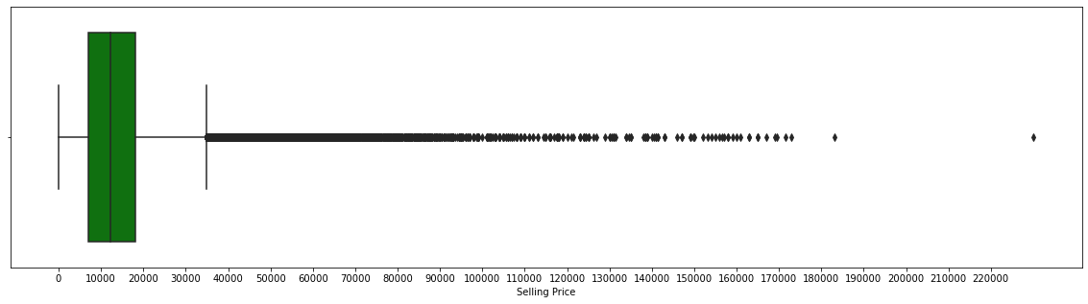
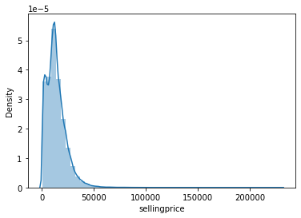
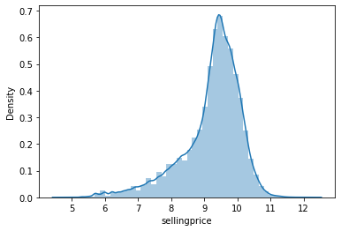
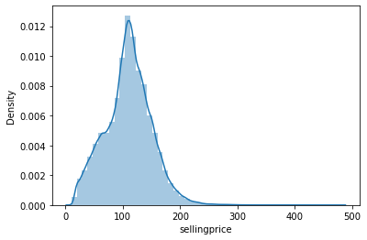
2. Data Exploration
Analyzed the saleprice – It had right skewed distribution, and lot of outliers in the right because of luxury cars, tried to convert into log normalization and sqrt normalization
Actual
Log
SQRT

Slide 9
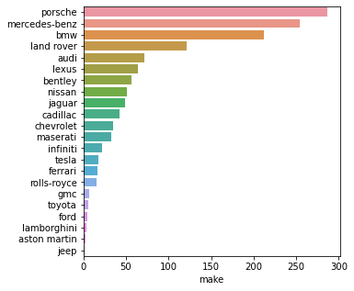
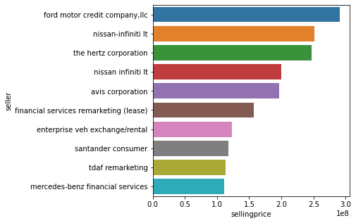
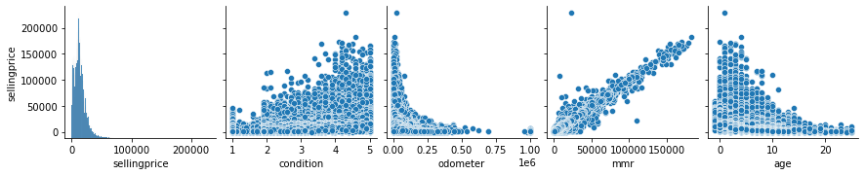
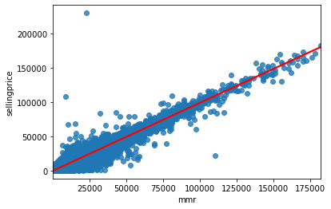
3. Data Visualizations
Most selling Luxury Cars
Top 10 seller by revenue
Pair Plot of Numerical columns vs selling price
Best Fit line Sale Price ~ mmr

Slide 10
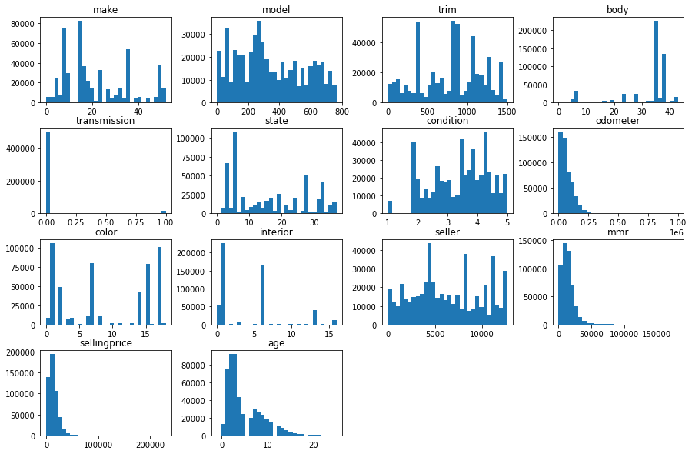
Histogram for all the variables

Slide 11
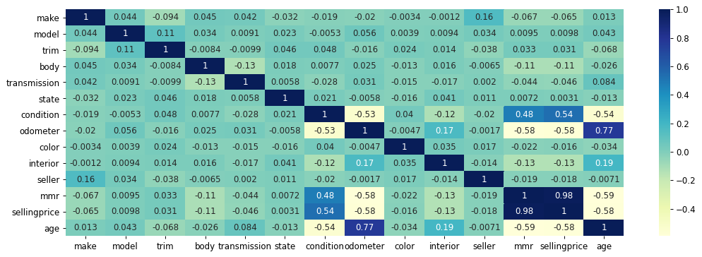
Data Preprocessing
Performed Label Encoding like converted transmission column instead of automatic/manual into 0/1.
Performed Feature scaling, converted sale price into sqrt normalization.
Created heatmap of correlation matrix as given below
- age and odometer are strongly correlated because If Age increases then Odometer also increases.
- mmr and sellingprice are also strongly correlated because if mmr is high then price is also high, therefore mmr is the good indicator of price.
- age and selling price is also strongly correlated but in negative way as age increases price of the car decreases.

Slide 12
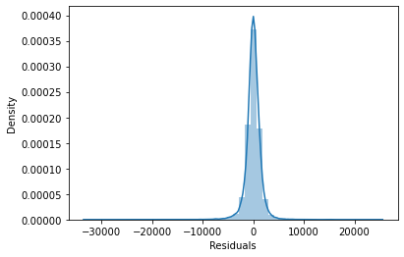
4. Data Modeling
Because target variable is continuous So, I need to apply regression i.e. supervised machine learning method.
There are mainly four regression models
Linear Regression --- 1. Simple Linear Regression 2. Multiple Linear
Regression Support Vector Regressor
Decision Tree Regressor
Random Forest Regressor
I will use Multiple Linear Regression Model Here.
Model’s Performance
Mean Squared Error: 2309084.6721928953
Root Mean Squared Error: 1519.5672647806332
Mean Absolute Error: 982.2882377879719
R Squared: 0.974400609646132
Residuals distribution
Residual terms are normally distributed here.

Slide 13
5. Improving the model - Stepwise Feature Selection
STEPWISE SELECTION ALGORITHM STEPS:
1. Start with the model having no independent variable.
2. Compute partial F-values for each of the independent variable.
3. Identify the variable which corresponds to highest partial F-value and add it to the model.
4. Compute partial F-values for remaining variables in presence of previously selected variables and identify the variable which corresponds to highest partial F-value and add it to the model if corresponding partial F-value > some threshold value.
5. All the variables which have been included in the model are tested for their significance in presence of other variables in model. All the variables which are no longer significant in presence of other variables in model are removed.
6. This algorithm terminates if at any stage we cannot add any additional variable into the model and all the variables which are there in the model are significant.
Selected Columns:
sellingprice | model | age | mmr | interior | state | color | condition | body | trim
Results:
Dep. Variable: | sellingprice | R-squared: | 0.973
Model: | OLS | Adj. R-squared: | 0.973
Method: | Least Squares | F-statistic: | 2.268e+06
Date: | Thu, 22 Jul 2021 | Prob (F-statistic): | 0.00
Time: | 23:03:13 | Log-Likelihood: | -4.4772e+06
No. Observations: | 509311 | AIC: | 8.954e+06
Df Residuals: | 509302 | BIC: | 8.955e+06
Df Model: | 8
Covariance Type: | nonrobust

Slide 14
Stepwise Feature Selection
Omnibus: | 567469.395 | Durbin-Watson: | 1.838
Prob(Omnibus): | 0.000 | Jarque-Bera (JB): | 8897547233.582
Skew: | 4.180 | Prob(JB): | 0.00
Kurtosis: | 650.460 | Cond. No. | 1.11e+05
 | coef | std err | t | P>|t| | [0.025 | 0.975]
const | -2152.3324 | 13.244 | -162.519 | 0.000 | -2178.289 | -2126.375
mmr | 0.9504 | 0.000 | 3509.484 | 0.000 | 0.950 | 0.951
seller | 0.0032 | 0.001 | 5.282 | 0.000 | 0.002 | 0.004
color | 2.0600 | 0.345 | 5.963 | 0.000 | 1.383 | 2.737
interior | 4.8660 | 0.549 | 8.857 | 0.000 | 3.789 | 5.943
body | -8.1750 | 0.245 | -33.322 | 0.000 | -8.656 | -7.694
transmission | -176.0955 | 12.948 | -13.600 | 0.000 | -201.473 | -150.718
condition | 839.3353 | 2.709 | 309.812 | 0.000 | 834.025 | 844.645
model | 0.0682 | 0.010 | 6.551 | 0.000 | 0.048 | 0.089
Durbin - Watson tells about autocorrelation if it is close to 0 then there is autocorrelation and if it is close to 2 then there is no autocorrelation.

Slide 15
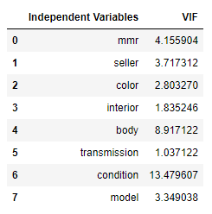
Handling Multicollinearity
condition and body columns have VIF > 5 So I dropped both one by one.
Then R-Squared is 0.968 i.e. quite good.

Slide 16
Conclusion
Final Results of the model.
Mean Squared Error: 2923102.977177814
Root Mean Squared Error: 1709.7084480044584
Mean Absolute Error: 1088.6393668827159
R Squared: 0.9679257611101504
Now we can apply the model for business problem.

Slide 17
Thank you

